Slide 1

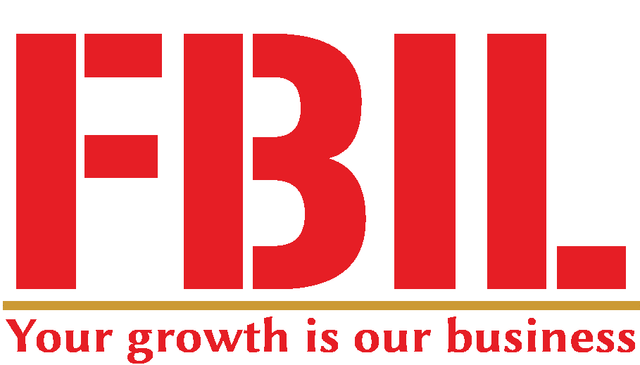
Unleashing Business Growth with FBIL
Your Growth is Our Business
www.fbilindia.in.
Discover how Business Now India empowers organizations to unlock new revenue streams, Improve Profitability and drive sustainable growth.

Slide 2
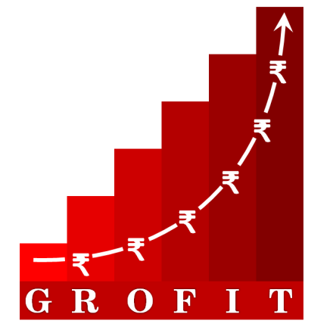

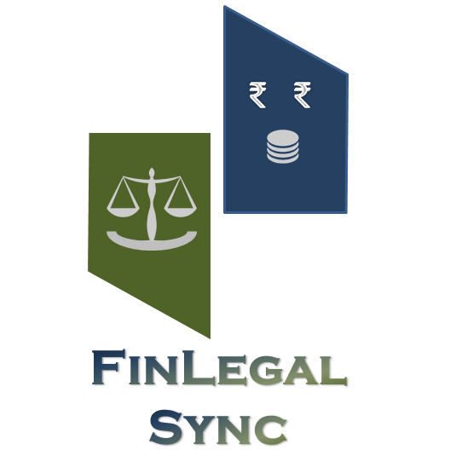
What we do
  Create & Implement Growth Strategy & Plans to Achieve Exponential Growth, New Revenue Channels, New Business Verticals while Optimizing the Profitability and making Business Models Asset Light
  Make Business More Profitable By Digitizing Business Processes, Improving Efficiency and fostering growth.
  Integration of various IT Systems across Ops, Sales, Marketing and Financial Controls
  We Optimize Fund Requirements with Business Model Refinements and help in Financial Syndication and Fund Generations by creating investible Business Models
www.fbilindia.in.
Saving our clients time and money, achieving growth and improving profitability

Slide 3
FBIL Services
Brand Identity Formulation
  Crafting a compelling brand narrative and visual identity.
Market Expansion
  Identifying and penetrating new markets for business growth.
Sales Channel Development
  Establishing effective distribution channels and sales networks.
Franchisee Network Development
  Facilitating franchise expansion and partner onboarding.
Customer Management
  Implementing strategies for customer acquisition and retention.
Marketing Strategy Refinement
  Optimizing marketing efforts for maximum impact and ROI.
Competitive Intelligence
  Gaining insights into market dynamics and competitor analysis.
Tech Enablement
  Leveraging cutting-edge technologies for operational efficiency.
E-commerce Implementation
  Establishing online sales channels and digital storefronts.
Digital Marketing
  Driving online visibility and engagement through various channels.
www.fbilindia.in.

Slide 4




Our Process: A Robust 4 Phase Approach
Discovery & Analysis
Strategic Planning
Implementation & Execution
Optimization & Reporting
Comprehensive assessment of client's business goals, target market, and competitive landscape to identify growth opportunities.
Developing a tailored roadmap and actionable strategies aligned with the client's growth objectives, leveraging data-driven insights.
Seamless execution of the growth strategies through effective project management, resource allocation, and continuous monitoring.
Measuring and analyzing key performance indicators, iterating strategies for continuous improvement, and providing detailed reports on outcomes.
www.fbilindia.in.

Slide 5
Phase 1: Business Diagnostic & Landscape Mapping
Current business analysis
  Comprehensive evaluation of existing business strategy, operations, value propositions, and market positioning.
Strengths and weaknesses
  Identifying core competencies, competitive advantages, and areas for improvement within the organization.
Opportunities and threats
  Assessing external factors, market trends, and potential risks or prospects for growth and innovation.
Commercial model review
  Examining revenue streams, pricing strategies, and business model viability for optimization and future scalability.
Value chain optimization
  Streamlining processes, identifying inefficiencies, and enhancing operational capabilities for improved productivity.
Competitive landscape
  Analyzing competitors' offerings, strategies, and market positioning to gain a competitive edge.
Rebranding and repositioning
  Evaluating the need for revitalizing the brand identity, messaging, and market positioning for increased relevance and impact.
Market segmentation and targeting
  Identifying and prioritizing target customer segments, tailoring value propositions, and aligning marketing efforts accordingly.
Marketing strategy refinement
  Developing robust marketing plans, channels, and tactics to effectively reach and engage target audiences.
www.fbilindia.in.

Slide 6
Phase 2: Creating Win-Win Business Models & Channel Architecture
Critical enablers and technology solutions
  Identify key enablers, such as resources and technology, to support operations.
Define roles and responsibilities
  Clearly delineate roles and responsibilities for stakeholders and partners.
Legal and commercial models
  Establish legal frameworks and commercial models for engaging channel partners.
Finalize business model
  Define revenue streams, cost structures, and value propositions for stakeholders.
Channel architecture design
  Establish a robust network of partners, suppliers, and distribution channels.
Service design and delivery channels
  Develop customer-centric services and identify optimal delivery channels.
www.fbilindia.in.

Slide 7
Phase 3: Roll-Out of Business Initiatives
Target Customer Profiling
  Conduct market research to identify key demographics, psychographics, and buying behaviors.
Develop Integrated Marketing Strategy
  Craft a comprehensive plan encompassing digital, traditional, and experiential marketing channels.
Establish Channel Partner Network
  Identify and onboard strategic partners to expand reach and enhance customer experience.
Implement Omnichannel Architecture
  Build a cohesive channel ecosystem, ensuring seamless integration across all touchpoints.
Launch Digital Initiatives
  Leverage cutting-edge digital technologies to drive engagement, conversion, and retention.
Implement E-Commerce Systems
  Develop robust e-commerce platforms to facilitate seamless online transactions and enhance customer convenience.
www.fbilindia.in.

Slide 8
Phase 4: Continual Support & Refinement
Operational Issue Resolution
  Implement streamlined procedures to address operational inefficiencies and bottlenecks.
Service Optimization
  Continuously gather customer feedback and refine services to enhance satisfaction.
Marketing Strategy Refinement
  Analyze market trends and adjust marketing campaigns for maximum impact.
Supply Chain Optimization
  Optimize supply chain processes for cost-effective and timely delivery of goods and services.
Sustainable Business Processes
  Establish robust processes to ensure long-term growth and profitability.
www.fbilindia.in.

Slide 9
Our Values: ACTION
Accountability
  Taking full responsibility for our actions, decisions, and commitments, ensuring alignment with organizational goals and fostering a culture of ownership.
Candour
  Embracing open and honest communication, fostering a culture of trust and transparency by addressing challenges and concerns directly and constructively.
Transparency
  Promoting an environment of openness, where information flows freely, decisions are made openly, and processes are clear and accessible to all stakeholders.
Innovation
  Encouraging continuous improvement, embracing change, and fostering an environment that nurtures creativity, risk-taking, and the exploration of new ideas and solutions.
Ownership
  Taking pride in our work, actively contributing to the organization's success, and being proactive in identifying and addressing challenges and opportunities.
Nimble
  Maintaining agility and adaptability to respond swiftly to changing market conditions, customer needs, and emerging opportunities, ensuring our competitiveness and resilience.
www.fbilindia.in.

Slide 10
Our Belief
“Alone we can do so little, together we can do so much.”
Your Growth is Our Business
www.fbilindia.in.

Slide 11




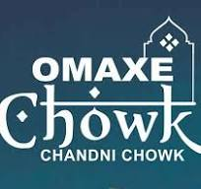






Some of Our Associations and Growth Cases
Sawansukha
JEWELS
ALFISOL FOODS
www.fbilindia.in.

